Slide 1
Security Information and Event Management Services
June, 2011
Minsk, Belarus

Slide 2
Security Information and Event Management
“SIEM technology is used to analyze security event data in real time for internal and external threat management, and to collect, store, analyze and report in log data for regulatory compliance and forensics”
“SIEM was $663.3 million in 2008 and is expected to grow up to $1.4 billion in 2013”

Slide 3
Presentation Plan
ScienceSoft’s SIEM Offerings at a Glance
SIEM Offerings in Detail:
for End-users
for Consultants and System Integrators
for SIEM Solution Vendors
Focal Competence: IBM Tivoli
Focal Competence: Event Sources & User Information Sources Development

Slide 4
1. ScienceSoft SIEM Offerings at a Glance
Advice in choosing SIEM solutions
SIEM systems discovery, design, deployment, configuration, and maintenance
Development of Event Sources and User Information Sources
Security systems audit
Subcontracting of SIEM systems design, implementation and maintenance
SIEM consulting / development resources
Development of Event Sources and User Information Sources
Subcontracting in product components development
Event Sources and User Information Sources development, testing, and integration
SIEM End users
Consultants
System integrators
SIEM
Solution vendors

Slide 5
2. Offerings – for End-users
Already have a SIEM solution installed?
Yes
No
We provide support and customization:
ArcSight RSA EnVision
IBM TSIEM
Quest Software
Q1 Labs Qradar
Symantec SSIM
NetIQ
Cisco MARS
CA Enterprise Log Management
We provide full cycle
consulting:
Security systems audit
Advice in choosing SIEM solutions
SIEM consulting, implementation, configuration, and support or maintenance
Development of Event Sources and User Information Sources

Slide 6
2. Offerings – for Consultants and System integrators
Subcontracting in TCIM, TSIEM, and TSOM products deployment, configuration, and support
Subcontracting in SIEM system design, implementation and maintenance
Subcontracting in LM, SIM, SEM, and SIEM products deployment, configuration, and support
SIEM consulting / development resources
Development of Event Sources and User Information Sources

Slide 7
2. Offerings – for SIEM Solution Vendors
Subcontracting in product components development
Event Sources and User Information Sources development, testing, and integration
Practical assistance with the existing Event Sources and User Information Sources;
Full support for unique sources of audit data
Customize/update Compliance Management Modules (CMM) and Reports to support regulatory and security standards

Slide 8
3. Focal Competence – IBM Tivoli: TCIM, TSIEM, and TSOM
Services
IBM TCIM, TSIEM, and TSOM deployment, configuration, and maintenance
IBM TCIM and TSIEM Event Sources, User Information Sources, Compliance Management Module customization and development
IBM TSOM Device Rules development
IBM TCIM, TSIEM, and TSOM products customization
Key points
Expert knowledge in IBM TCIM, TSIEM, and TSOM architecture and implementation
Wide experience in TCIM, TSIEM, and TSOM deployment, configuration, support, and maintenance
Deep knowledge in operating systems, software and devices audit, logging, and security subsystems
Experience in configuring and maintaining operating systems, software, and devices (including almost all Tivoli’s)

Slide 9
3. Focal Competence – Experience with TCIM and TSIEM
Participation in development of key product components
Core functionality (server, database engine, mapper, agents, web application)
UI (including redesign and migration to web-based UI)
Completely responsible for Event Sources and User Information Sources
Compliance Management Modules
Quality assurance and testing
Established significant number of QA procedures
Full cycle of TCIM and TSIEM releases testing
Completely responsible for Event Sources and User Information Sources testing
Completely responsible for Compliance Management Modules testing
Support activities
L3 support (including regular fixpacks development and testing)
Maintenance of specific building environments

Slide 10
3. Focal Competence - IBM Tivoli: Milestones and Accomplishments
Milestones
2004 ScienceSoft became a software vendor for Consul Risk Management
2007 IBM acquired Consul Risk Management
2008
ScienceSoft became completely responsible for TCIM and TSIEM Event Sources and TSOM Device Rules development
2009
ScienceSoft picked up TCIM and TSIEM Compliance Management Modules development
Deliveries
3 major releases of Consul InSight Security Manager (CISM) (2004-2006)
2 major releases of IBM TCIM (2007-2008)
3 major releases of IBM Tivoli Security Information and Event Manager (TSIEM) major releases (2009-2011)
More than 120 completed CISM, TCIM, and TSIEM Event Sources and Compliance Management Modules projects
More than 30 completed TSOM device rules projects

Slide 11
4. Focal Competence - Event Sources & User Information Sources
Full cycle of Event Sources and User Information Sources development and testing
Requirements clarification and analysis; investigation of target platform
Security subsystem and audit settings analysis
Architecture and design, W7 model mapping design
ES and UIS development, integration to TCIM and TSIEM releases
ES and UIS testing (all of configurations, all of supported platforms)
Development tools and environment
Operating systems: IBM AIX, HP-UX, Sun Solaris, RHEL, SUSE, MS Windows, OS400, z/OS, zLinux
TCIM and TSIEM internal development tools and languages: GVS, GSL, GML, Pearl
Any programming language or development tool to provide better design and implementation of required functionality

Slide 12
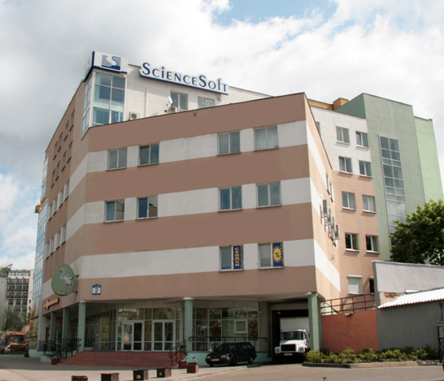
Contact Details
SCIENCESOFT, INC.
4th Floor, 2 Bedy Str.,
220040 Minsk, Belarus
Phone: + 375 17 293 3736
USA phone: +1 619 822 2935
USA Fax: +1 617 249 0477
Email: contact@scnsoft.com
Web: www.scnsoft.com
SCIENCESOFT OY
Porkkalankatu 20 A
00180 Helsinki, Finland
Phone: +358 50 388 3000
Email: contact@scnsoft.fi
Web: www.scnsoft.fi

